Slide 1
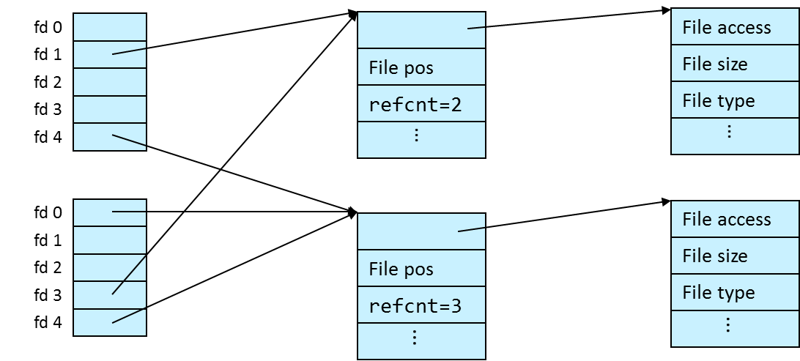
Input/Output Files and Directories

Slide 2
Class Outline
File Metadata
Directories
Kernel File Management
Summary

Slide 3
File Metadata
struct stat {
dev_t st_dev;
ino_t st_ino;
mode_t st_mode;
nlink_t st_nlink;
uid_t st_uid;
gid_t st_gid;
dev_t st_rdev;
off_t st_size;
blksize_t st_blksize;
blkcnt_t st_blocks;
struct timespec st_atim;
struct timespec st_mtim;
struct timespec st_ctim;
};

Slide 4
File Metadata
Metadata is data about data, in this case information about a file
filename
file type
file size
file creation, modification, and access time
file access permissions
…
Per-file metadata maintained by kernel
not all metadata is stored in the same place
filename: stored in the directory that contains the files
everything else is stored in the inode of the file
inode: internal storage unit used by Unix file systems

Slide 5
File Metadata
File metadata can be accessed with the *stat* family of Unix I/O API calls
return the file metadata in a struct stat
struct stat { dev_t st_dev; // device ino_t st_ino; // inode mode_t st_mode; // protection and file type nlink_t st_nlink; // number of hard links uid_t st_uid; // user ID of owner gid_t st_gid; // group ID of owner dev_t st_rdev; // device id (if special file) off_t st_size; // total size, in bytes unsigned long st_blksize; // preferred blocksize for filesystem I/O unsigned long st_blocks; // number of 512B blocks allocated // high-precision timestamps (precision: nanoseconds; since Linux kernel >=2.6) struct timespec st_atim; // time of last access struct timespec st_mtim; // time of last access struct timespec st_ctim; // time of last status change // low-precision timestamps (precision: seconds; always available) time_t st_atime; // time of last access time_t st_mtime; // time of last modification time_t st_ctime; // time of last status (inode) change };

Slide 6
File Metadata
struct stat
manual: stat(2), inode(7)
st_mode enodes the type and access permissions of a file
use S_IS***(stat.st_mode) macros for convenience if (S_ISREG(stat.st_mode)) // regular file
use S_IR/W/X*** masks to check the access permissions if (stat.st_mode & S_IRUSR) // owner has read permission
st_uid / st_gid
use getpwuid(stat.st_uid) / getgrgid(sb.st_gid) to retrieve user/group information
st_size vs. st_blocks
file is sparse if st_size / 512 > st_blocks(# of 512B blocks allocated)
A sparse file contains a small portion of non-zero bytes

Slide 7
File Metadata
struct stat
timestamps
st_?tim: nanosecond precision since Linux 2.6
st_?time: Unix / Linux <2.6 low-resolution timestamps (precision: seconds)
traditionally, Unix filesystems did not record a file’s creation date (birth date)
newer file systems may support it, retrieve via statx() system call
st_ctim[e] vs st_mtim[e]
ctim[e]: timestamp of last update to file inode (file meta data)
mtim[e]: timestamp of last update to file data
st_atim[e]
time stamp of last access to file
often disabled for performance reasons (mount filesystem with -o noatime)

Slide 8
File Metadata
C standard library functions to access file metadata (header sys/stat.h)
Operation | API | Remarks
Retrieve file metadata | int stat(const char *pathname, struct stat *statbuf)
 | int lstat(const char *pathname, struct stat *statbuf) | does not follow symbolic links
 | int fstat(int fd, struct stat *statbuf)
 | int fstatat(int dirfd, const char *pathname, struct stat *statbuf, int flags) | useful when stat-ing files in a directory
 | int statx(int dirfd, const char *pathname, int flags, unsigned int mask, struct statx *statxbuf) | get extended file status

Slide 9
Directories
|-a
| `-b
| |-c
| | `-d
| `-f
|-dir1
| `-seventyfive
|-dir2
| |-three
| `-seven
`-dir3
|-five `-twentytwo

Slide 10
Directories
C standard library functions to deal with directories (headers dirent.h, sys/types.h)
Operation | API | Variants
Open | DIR* opendir(const char *name) | fdopendir
Read entry | struct dirent* readdir(DIR *dirp)
Close | int closedir(DIR *dirp)
Retrieve descriptor | int dirfd(DIR *dirp)
Make directory | int mkdir(const char *pathname, mode_t mode) | mkdirat

Slide 11
Example: Accessing Directories and File Metadata
#include <…>
int main(int argc, char *argv[])
{
DIR *dir = opendir(argc > 1 ? argv[1] : ".");
if (dir == NULL) { perror("Cannot open directory"); return EXIT_FAILURE; }
int dd = dirfd(dir);
struct dirent *e;
errno = 0;
while ((e = readdir(dir)) != NULL) {
struct stat sb;
if (fstatat(dd, e->d_name, &sb, 0) < 0) {
perror("Cannot stat file");
} else {
printf(" %-32s %10ld\n", e->d_name, sb.st_size);
}
errno = 0;
}
if (errno != 0) perror("Cannot enumerate directory");
closedir(dir);
return EXIT_SUCCESS;
}
$ ./statter /
opt 4096
sys 0
proc 0
devnull 64
usr 4096
lib64 12288
home 4096
. 4096
data 4096
var 4096
lost+found 16384
.. 4096
dev 4300
...
statter.c

Slide 12
Kernel File Management

Slide 13
How the Unix Kernel Represents Open Files
Two descriptors referencing two distinct open disk files. Descriptor 1 (stdout) points to terminal, and descriptor 4 points to open disk file
in-memory metadata for a file
Descriptor table
[one table per process]
Open file table
[shared by all processes]
v-node table
[shared by all processes]
File A (terminal)
stdin
fd 0
File access
stdout
fd 1
File pos
File size
Info in
stat struct
stderr
fd 2
fd 3
refcnt=1
File type
fd 4
...
...
File B (disk)
File access
File pos
File size
refcnt=1
File type
...
...

Slide 14
File Sharing
Two distinct descriptors sharing the same disk file through two distinct open file table entries
E.g., Calling open twice with the same filename argument
Descriptor table
[one table per process]
Open file table
[shared by all processes]
v-node table
[shared by all processes]
File A (disk)
stdin
fd 0
File access
stdout
fd 1
File pos
File size
stderr
fd 2
fd 3
refcnt=1
File type
fd 4
...
...
File A (disk)
File pos
refcnt=1
...

Slide 15
I/O Redirection
I/O redirection is one of the core concepts of Unix
$ ls > output.txt $ ls | sort –R
$ cat < input.txt
How does a shell implement I/O redirection?

Slide 16
File Descriptor Manipulation
C standard library functions allow manipulation of file descriptors (header unistd.h)
Operation | API | Remarks
Duplicate file descriptor | int dup(int oldfd) | Returned fd points to same entry in open file table as oldfd
Duplicate file descriptor to specific fd | int dup2(int oldfd, int newfd) | Entry in newfd is overwritten with value in oldfd
Retrieve file descriptor of file stream | int fileno(FILE *stream)

Slide 17
File Descriptor Manipulation: dup()
fd = open("file.txt", O_RDONLY, 0);
fd2 = dup(fd);
Descriptor table
Open file table
v-node table
stdin
fd 0
File access
stdout
fd 1
file pos
File size
stderr
fd 2
fd
fd 3
refcnt=1
File type
fd 4
...
...
stdin
fd 0
File access
stdout
fd 1
file pos
File size
stderr
fd 2
fd
fd 3
refcnt=2
File type
fd2
fd 4
...
...

Slide 18
File Descriptor Manipulation: dup2()
fd = open("output.txt", O_WRONLY, 0);
dup2(fd, STDIO_FILENO);
Descriptor table
Open file table
v-node table
stdin
fd 0
…
File access
stdout
fd 1
file pos
File size
stderr
fd 2
fd
fd 3
refcnt=1
File type
fd 4
...
...
stdin
fd 0
File access
stdout
fd 1
file pos
File size
stderr
fd 2
fd
fd 3
refcnt=2
File type
fd 4
...
...

Slide 19
Fun with File Descriptors
What is the output of this program if the input file contains “System Programming”?
#include <…>
int main(int argc, char *argv[])
{
int fd1, fd2, fd3;
char c1, c2, c3;
char *fname = argv[1];
fd1 = open(fname, O_RDONLY, 0);
fd2 = open(fname, O_RDONLY, 0);
fd3 = open(fname, O_RDONLY, 0);
if ((fd1 == -1) || (fd2 == -1) || (fd3 == -1)) {
fprintf(stderr, "Cannot open input file.\n"); return EXIT_FAILURE;
}
dup2(fd2, fd3);
read(fd1, &c1, 1);
read(fd2, &c2, 1);
read(fd3, &c3, 1);
printf("c1 = %c, c2 = %c, c3 = %c\n", c1, c2, c3);
return 0;
}
Output: c1 = S, c2 = S, c3 = y
fwfd1.c

Slide 20
Fun with File Descriptors
What are the contents of the generated output file?
#include <…>
int main(int argc, char *argv[])
{
int fd1, fd2, fd3;
char *fname = argv[1];
if ((fd1 = open(fname, O_CREAT|O_TRUNC|O_RDWR, S_IRUSR|S_IWUSR)) == -1) {
perror("Cannot open output file"); return EXIT_FAILURE;
}
write(fd1, "CSAP", 4);
fd3 = open(fname, O_APPEND|O_WRONLY, 0);
write(fd3, "M1522", 5);
fd2 = dup(fd1); // Allocates descriptor
write(fd2, "SNU", 3);
write(fd3, “800", 3);
return 0;
}
File content: CSAPSNU22800
fwfd2.c

Slide 21
Summary
Summary
-------------
-------------
-------------
-------------
-------------
-----

Slide 22
Most Frequently Used Unix I/O System Calls
#include <unistd.h>
#include <fcntl.h>
#include <sys/types.h>
#include <sys/stat.h>
int open(const char *pathname, int flags[, mode_t mode]);
int creat(const char *pathname, mode_t mode);
ssize_t read(int fd, void *buf, size_t count);
ssize_t write(int fd, const void *buf, size_t count);
off_t lseek(int fd, off_t offset, int whence);
int stat(const char *path, struct stat *buf);
int close(int fd);
$ man –S 2 <func>

Slide 23
Most Frequently Used Standard I/O Library Calls
#include <stdio.h>
FILE* fopen(const char *pathname, const char *mode);
size_t fread(void *ptr, size_t size, size_t nmemb, FILE *stream);
size_t fwrite(const void *ptr, size_t size, size_t nmemb, FILE *stream);
int fflush(FILE *stream);
int feof(FILE *stream);
int ferror(FILE *stream);
off_t fseek(FILE *stream, long offset, int whence);
int f[get/set]pos(FILE *stream, fpos_t *pos);
int fclose(FILE *fp);
$ man –S 3 <func>

Slide 24
Most Frequently Used API to Manage Directories
#include <sys/types.h>
#include <dirent.h>
DIR* opendir(const char *name);
struct dirent *readdir(DIR *dirp);
int dirfd(DIR *dirp);
int closedir(DIR *dirp);
$ man –S 3 <func>

Slide 25
Aside: Working with Binary Files
Binary File Examples
Object code, Images (JPEG, GIF)
Functions you shouldn’t use on binary files
Line-oriented I/O such as fgets, scanf, printf
Different systems interpret 0x0A (‘\n’) (newline) differently:
Linux and Mac OS X: LF(0x0a) [‘\n’]
HTTP servers & Windows: CR+LF(0x0d 0x0a) [‘\r\n’]
String functions
strlen, strcpy
Interprets byte value 0 (end of string) as special

Slide 26

For Further Information
The Unix bible:
W. Richard Stevens & Stephen A. Rago, Advanced Programming in the Unix Environment, 3rd Edition, Addison-Wesley, 2013, ISBN 978-0321637734
Updated from Stevens’s 1993 classic text.

